Slide 1

Project A
Marc L Pierrot
Prof: Michael Garrett

Slide 2
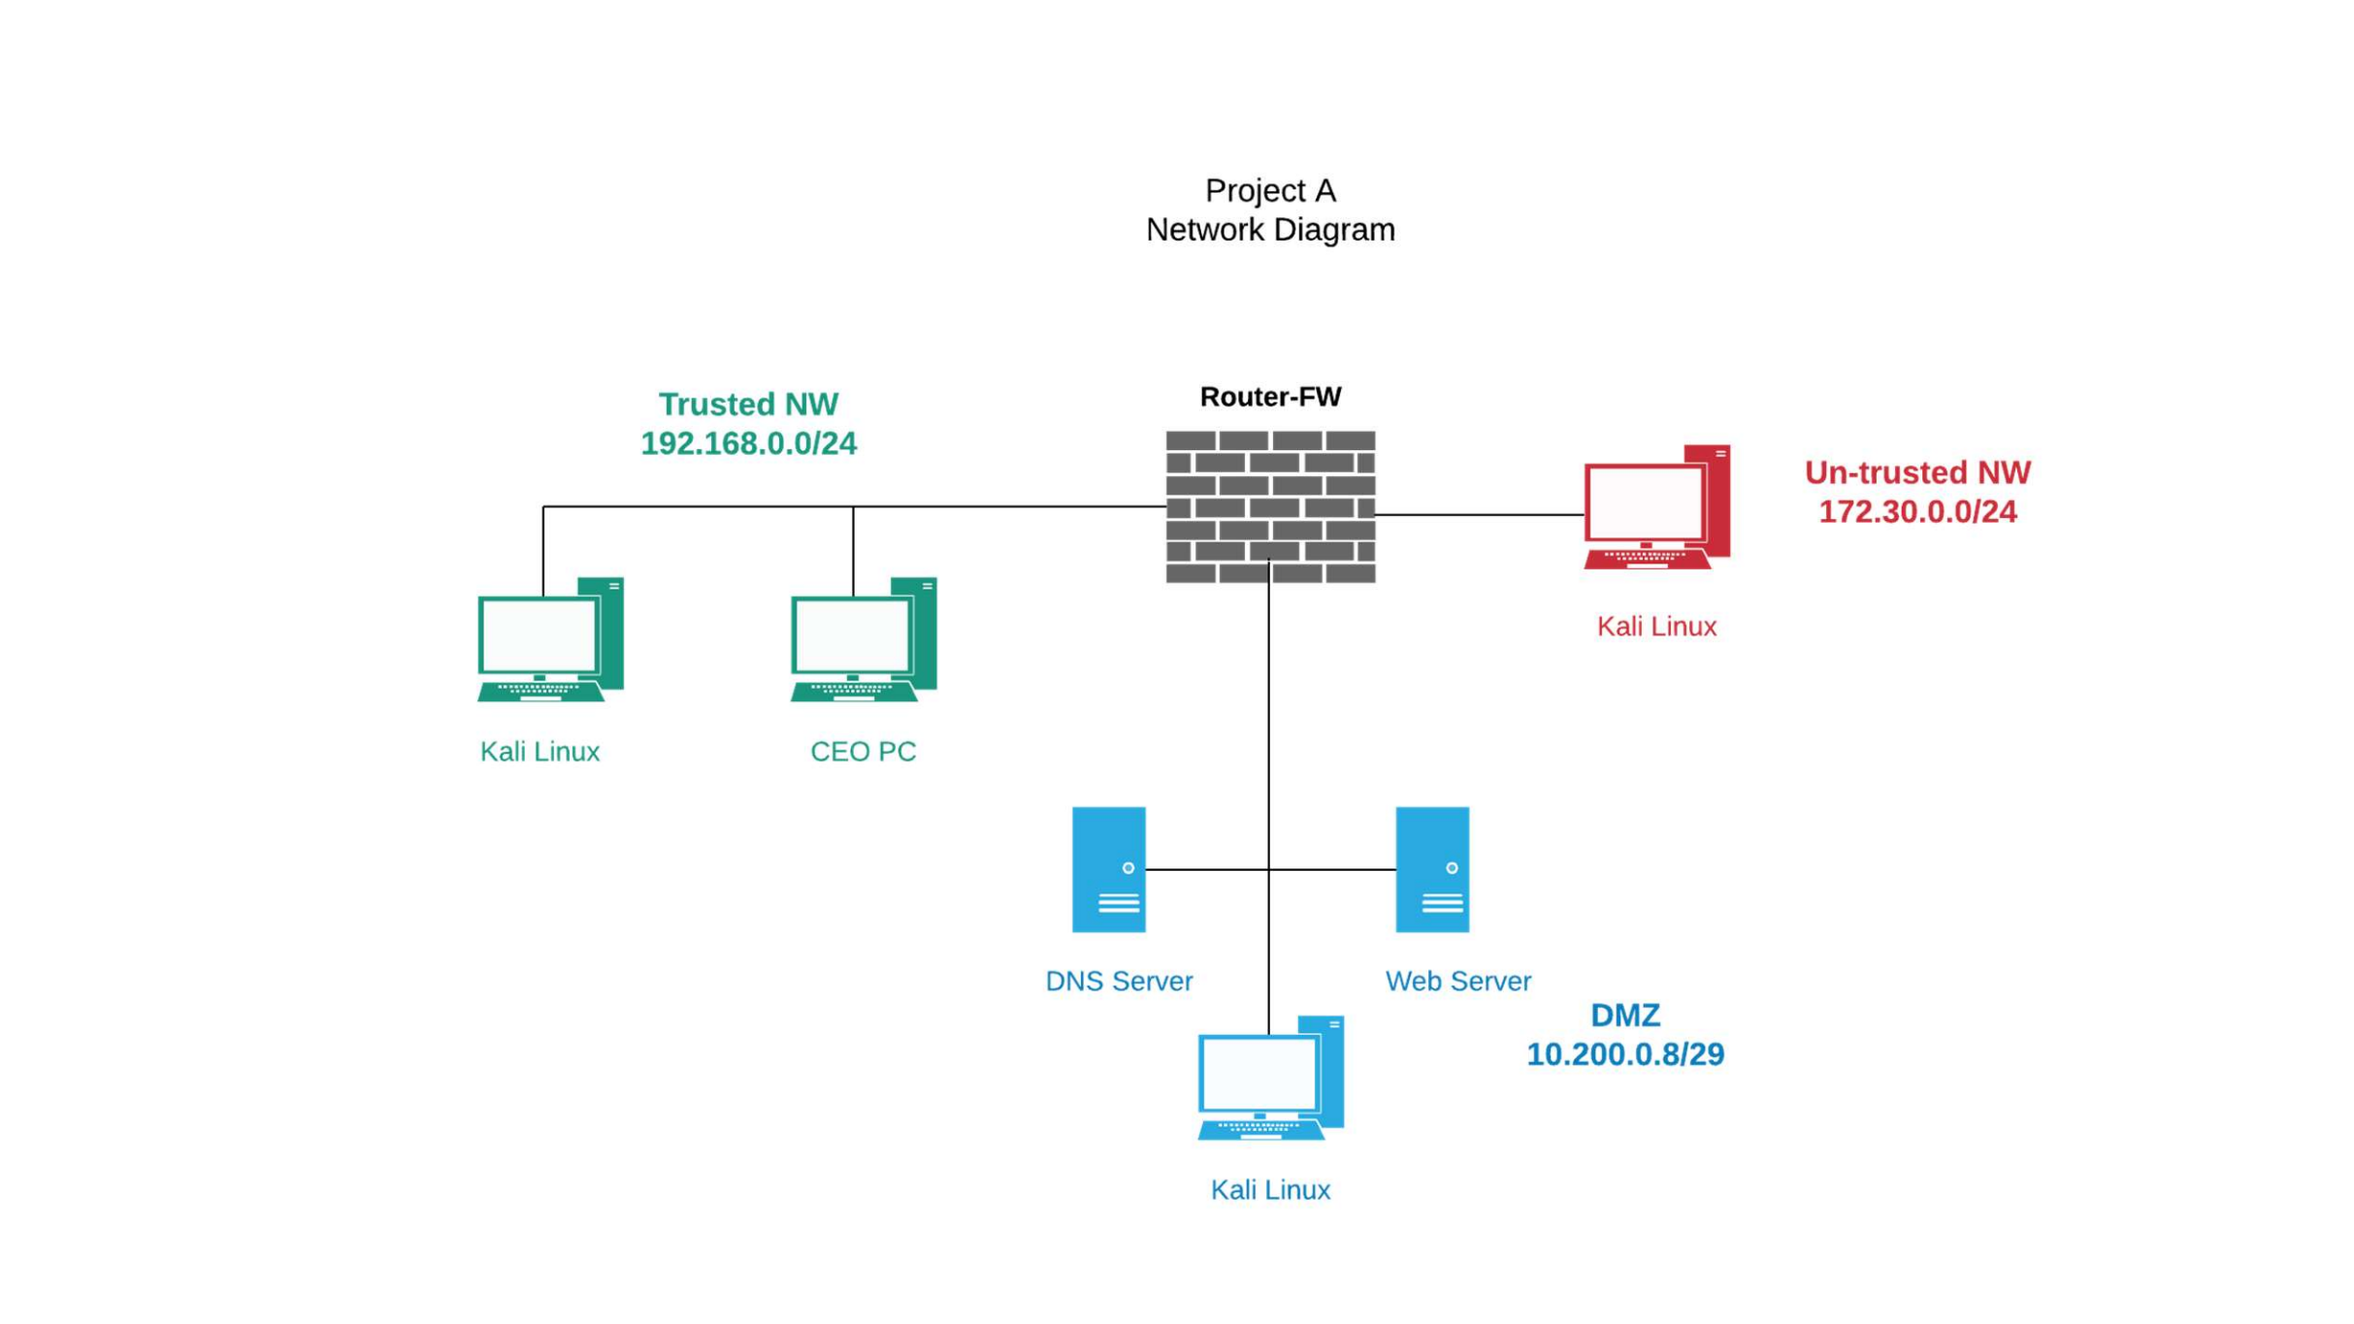
Network Diagram

Slide 3
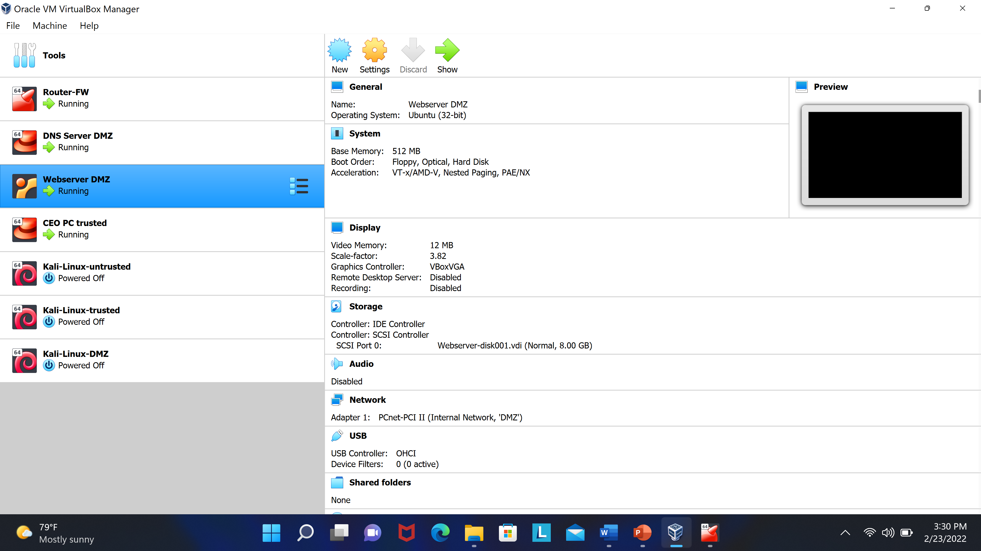
The Virtual Box

Slide 4
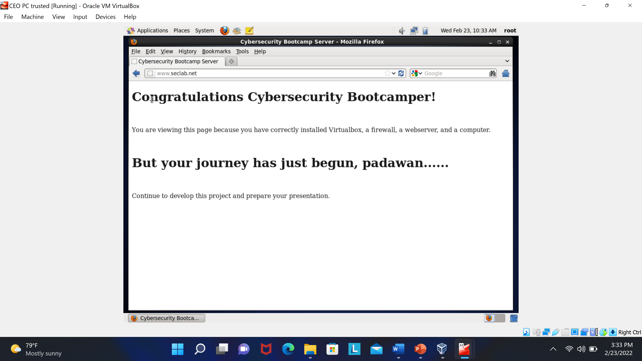
CEO PC Troubleshoot(connect to www.seclab.net)

Slide 5
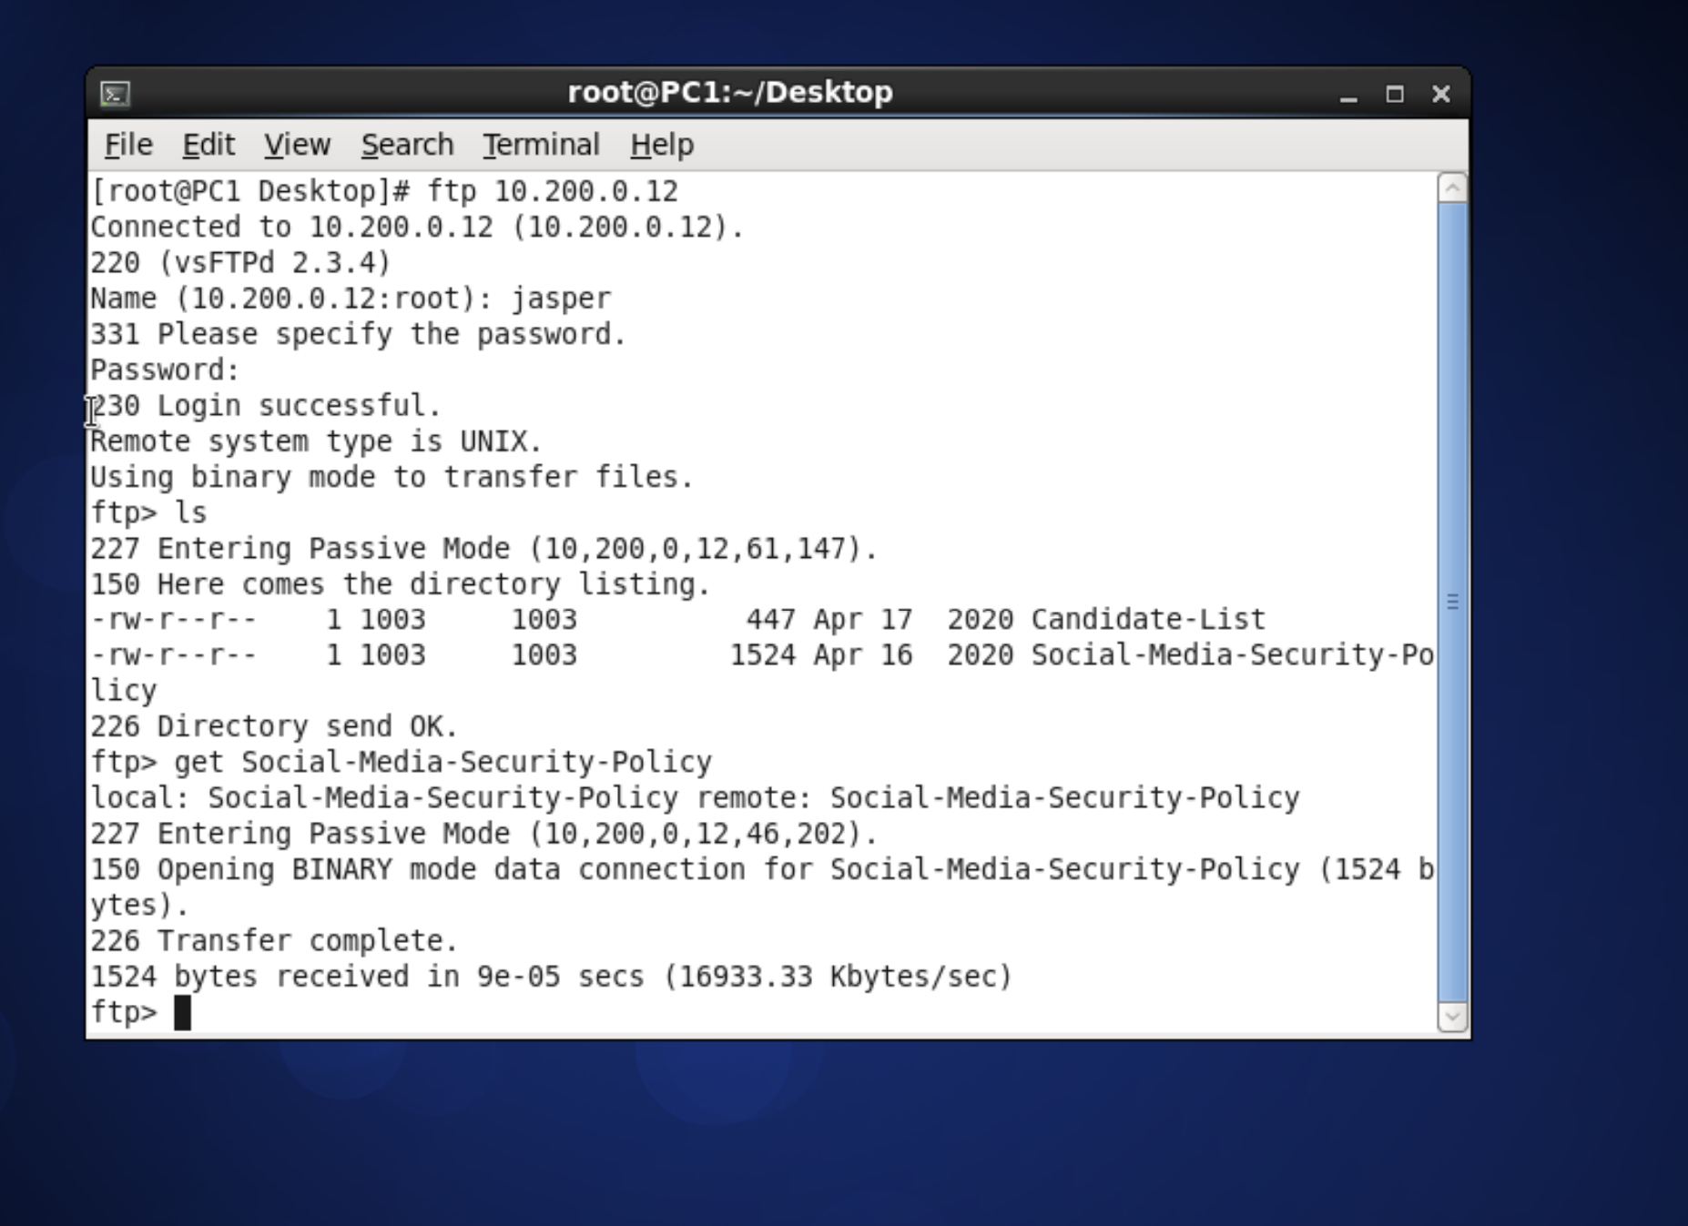
Social Media Security Policy(download)

Slide 6
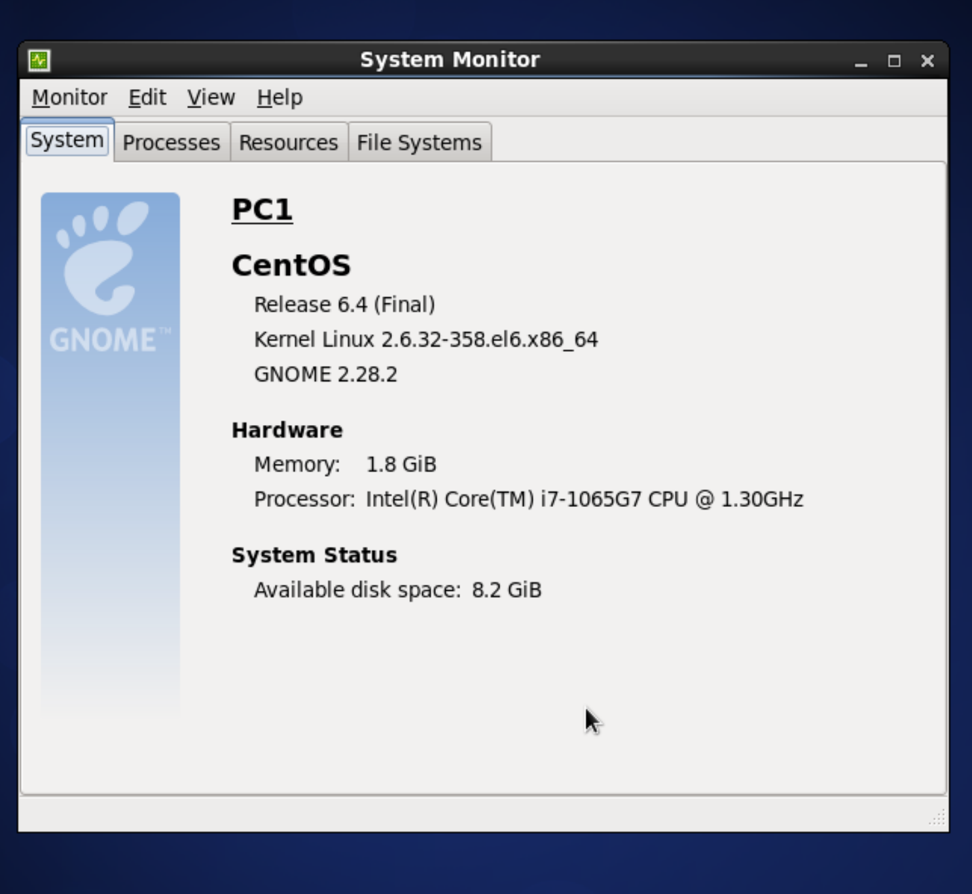
OS Version & IP Configuration
CEO PC
OS Version: Centos , Release 6.4
IP address: 192.168.0.24
Subnet Mask: 255.255.255.0
Default Gateway: 192.168.0.1
Web Servers
OS Version: Ubuntu 8.04
IP Address: 10.200.0.12
Subnet Mask: 255.255.255.0
Default Gateway: 10.200.0.9
DNS servers
OS Version: Red hat
IP Address: 10.200.0.11
Subnet Mask: 255.255.255.248
Default Gateway: 10.200.0.9

Slide 7
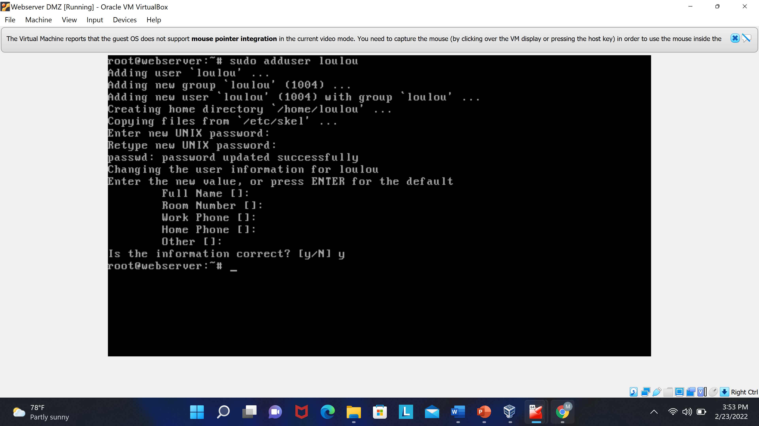
New User Name

Slide 8
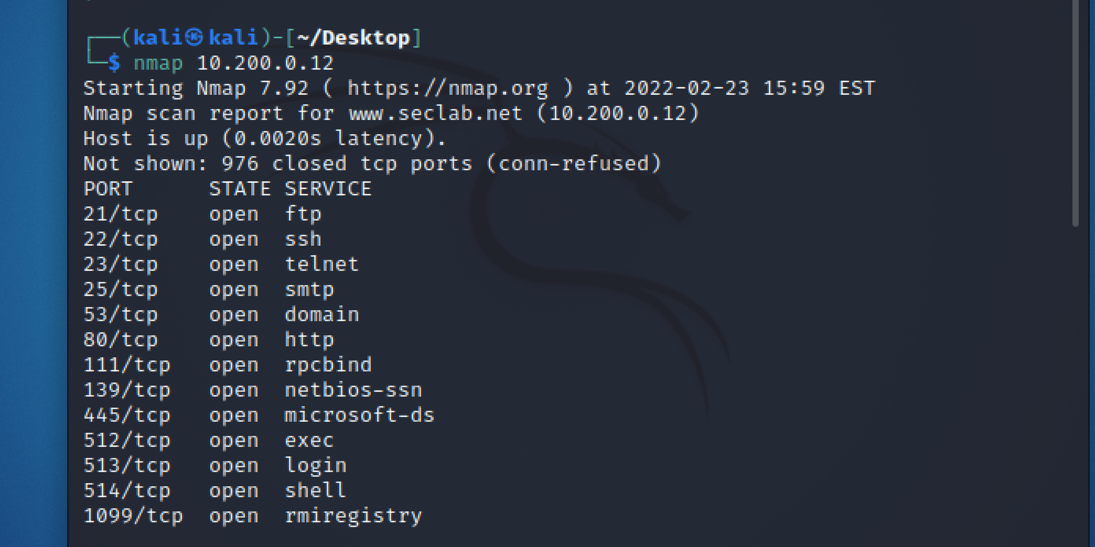
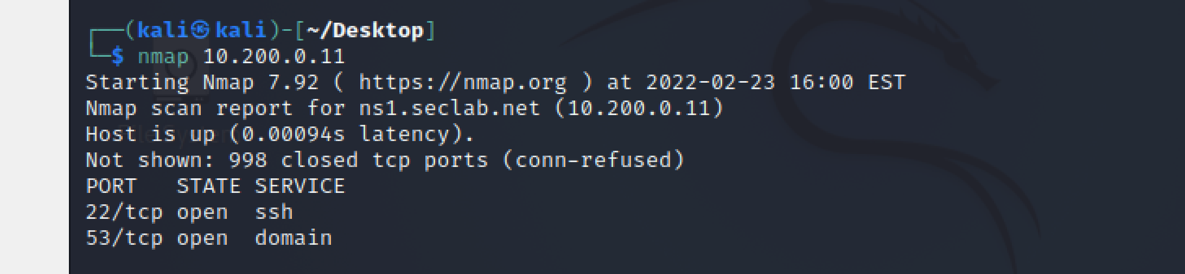
Scan on the DNS Server and the Web Server

Slide 9
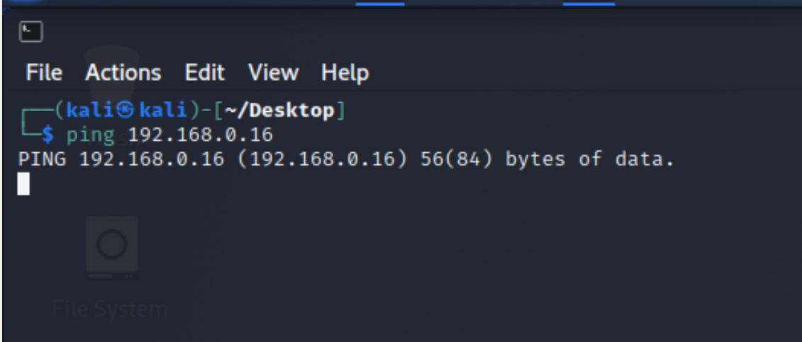
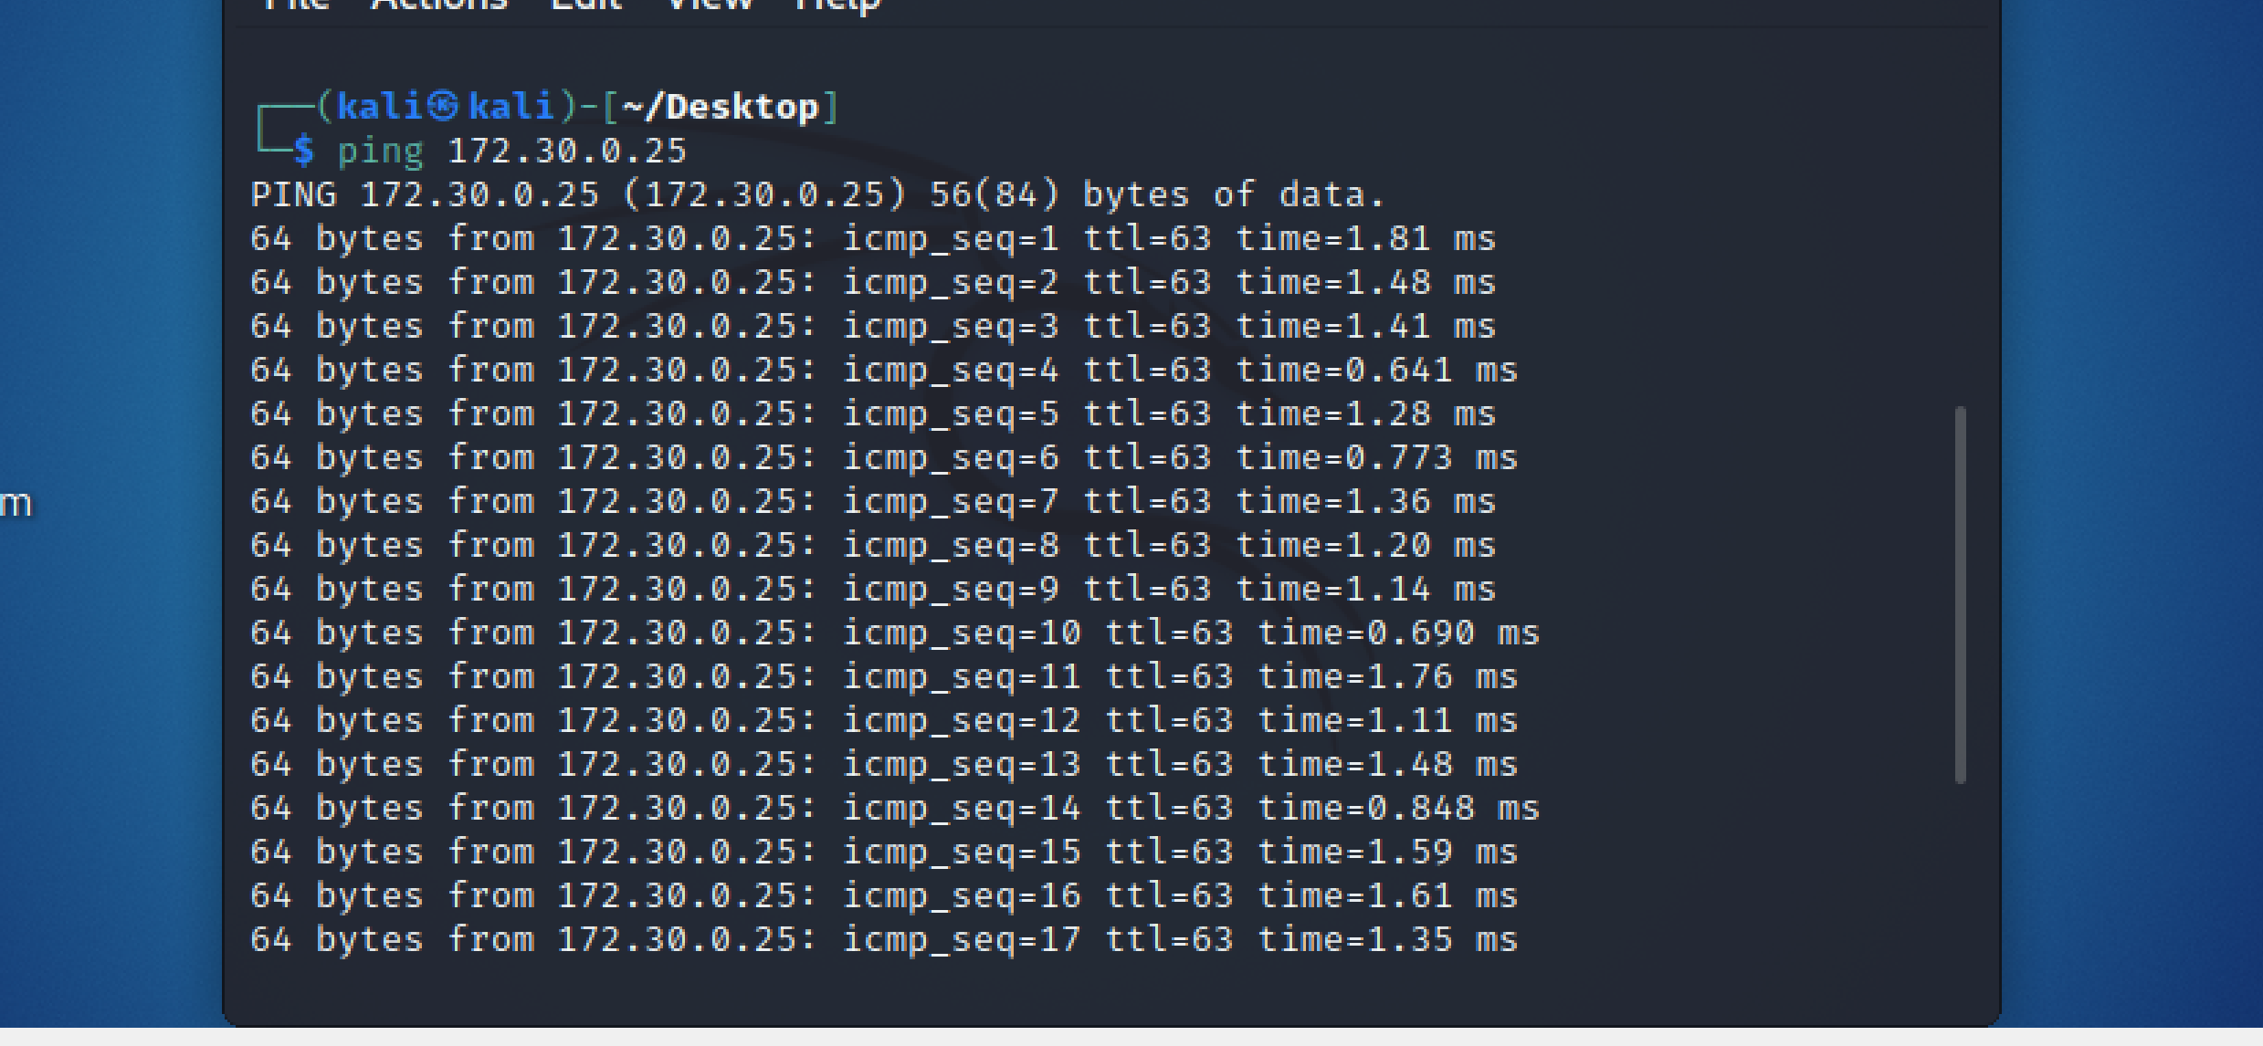
Trusted Network & Untrusted

Slide 10
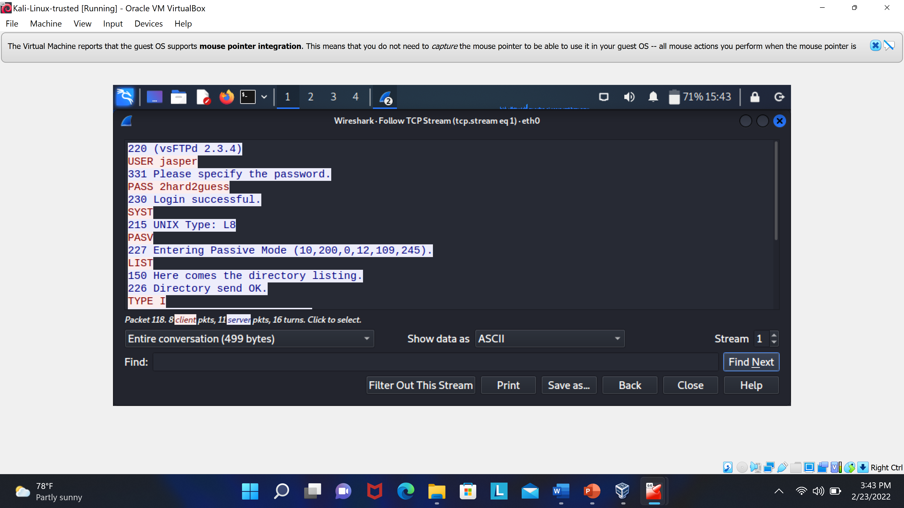
Wireshark Capture

Slide 11
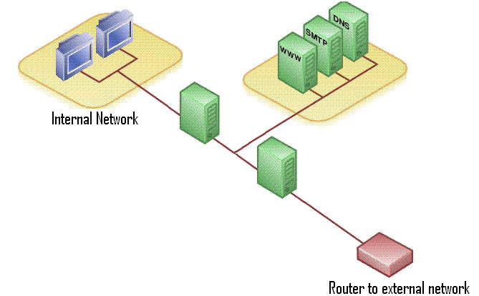
Recomandation

